Slide 1
Introduction to Programming
Lecture 11
Revision Lecture

Slide 2

Searching an Array Example
A function to search an element in an array and returns true if found and false otherwise
bool search(int arr[], int x)
{
for (int i = 0; i < SIZE ; i++)
{
if (arr[i] == x)
return true;
} //end of for loop
return false;
}
30 | 10 | 50 | 20 | 90 | 25 | 40
int main()
{
int arr[SIZE] = { 30,10,50,20,90,25,40 };
cout<<search(arr,10)<<endl;
cout <<search(arr, 60)<<endl;
return 0;
}
1
0

Slide 3




Searching an Array Example
bool search(int arr[], int x)
{
for (int i = 0; i < SIZE ; i++)
{
if (arr[i] == x)
return true;
else
return false;
}
}
Logic error

Slide 4
Bubble Sort Algorithm
We want to sort the array in ascending order (From smallest to largest)
arr[j]
arr[j+1]
Compare each element with its adjacent element
30 | 10 | 50 | 20 | 90 | 25 | 40
arr[j]
arr[j+1]
No swap
If arr[i]>arr[i+1]
make a swap
Then repeat comparison for next i
10 | 30 | 50 | 20 | 90 | 25 | 40
arr[j]
arr[j+1]
10 | 30 | 50 | 20 | 90 | 25 | 40

Slide 5

Bubble Sort
We want to sort the array in ascending order (From smallest to largest)
arr[j]
arr[j+1]
10 | 30 | 50 | 20 | 90 | 25 | 40
arr[j]
arr[j+1]
No swap
10 | 30 | 20 | 50 | 90 | 25 | 40
arr[j]
arr[j+1]
10 | 30 | 20 | 50 | 25 | 40 | 90
10 | 30 | 20 | 50 | 90 | 25 | 40
arr[j]
arr[j+1]
10 | 30 | 20 | 50 | 25 | 90 | 40

Slide 6

Bubble Sort
We want to sort the array in ascending order (From smallest to largest)
10 | 30 | 20 | 50 | 25 | 40 | 90
What is the last j could reach?
j = SIZE -1 -1 → j<SIZE-1
What did you accomplish with one traverse?
You pushed the largest number to the end in its correct place.

Slide 7


Bubble sort
Did you reach a sorted array with one traverse to the array?
for (int j = 0; j < SIZE - 1; j++)
{
if (arr[j] > arr[j + 1])
{
temp = arr[j];
arr[j] = arr[j + 1];
arr[j + 1] = temp;
}
}
No it is not enough
What shall you do?
Start traversing the array again
You need another loop to repeat the loop of comparison and swapping
10 | 30 | 20 | 50 | 25 | 40 | 90

Slide 8
Bubble sort
arr[j]
arr[j+1]
10 | 30 | 20 | 50 | 25 | 40 | 90
10 | 30 | 20 | 50 | 25 | 40 | 90
10 | 20 | 30 | 50 | 25 | 40 | 90
10 | 20 | 30 | 50 | 25 | 40 | 90
10 | 20 | 30 | 25 | 50 | 40 | 90

Slide 9


Bubble sort
void bubbleSort(int arr[])
{
int temp;
for (int i = 0; i < SIZE; i++)
{
for (int j = 0; j < SIZE - 1; j++)
{
if (arr[j] > arr[j + 1])
{
temp = arr[j];
arr[j] = arr[j + 1];
arr[j + 1] = temp;
}
}
}
}
→ Outer loop for repeating the traverse
→ Inner loop for comparing and swapping
Perfect – Unfortunately we can do better than that

Slide 10



Optimized Bubble sort
void bubbleSort(int arr[])
{
int temp;
for (int i = 0; i < SIZE - 1; i++)
{
for (int j = 0; j < SIZE – 1 - i; j++)
{
if (arr[j] > arr[j + 1])
{
temp = arr[j];
arr[j] = arr[j + 1];
arr[j + 1] = temp;
}
}
}
}
10 | 30 | 20 | 50 | 25 | 40 | 90
Remember: You pushed the largest number to the end in its correct place in each inner loop iteration.
Perfect

Slide 11
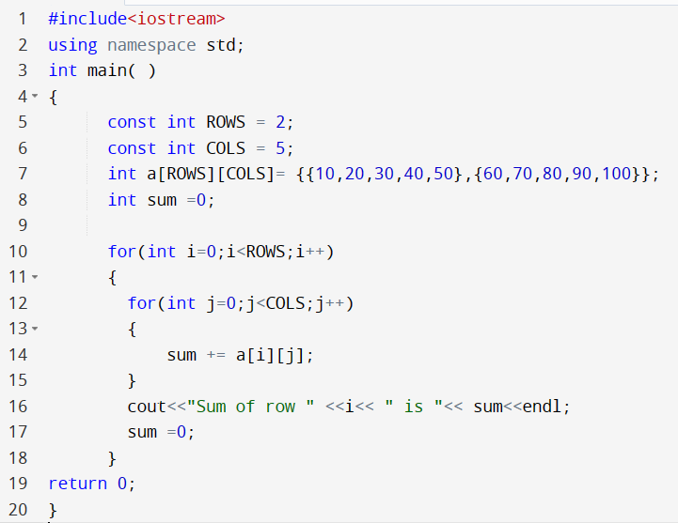
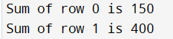
Sum of all rows
Write a program to print out the sum of all elements in each row of a 2D array.
a
10 | 20 | 30 | 40 | 50
60 | 70 | 80 | 90 | 100

Slide 12
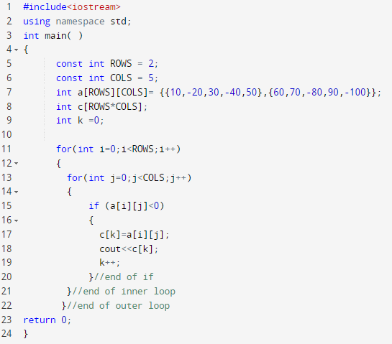

Extract negative numbers
j
i
10 | -20 | 30 | -40 | 50
60 | 70 | -80 | 90 | -100
a
Expected output array
c
-20 | -40 | -80 | -100
k
What is the size of array c?
We need a separate variable as an index to pass by c.

Slide 13
Functions and Passing parameters
Passing parameters
By Value
By Reference
Later in Functions part (2)

Slide 14
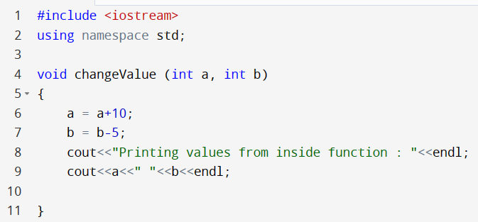
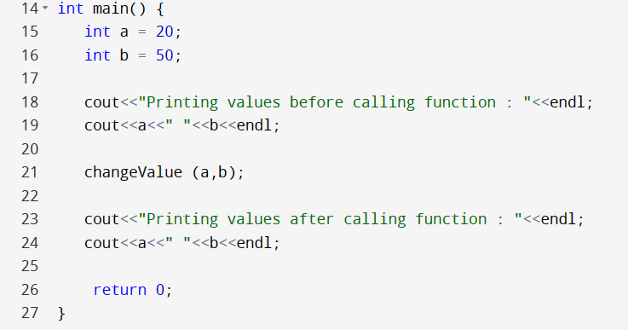

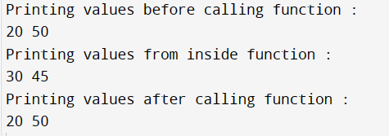
Passing parameters by value
Pass by Value (also known as pass-by-copy)
a
b
a
b
Passing parameters by coping the value
20
50
20
50
a
b
30
45

Slide 15
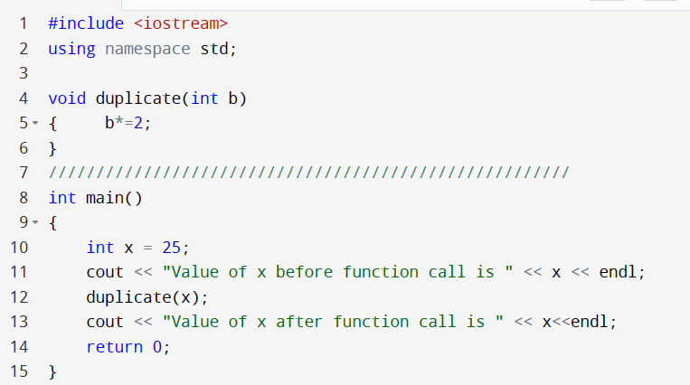
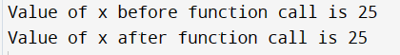
Passing parameters by Value
Memory
25
x
b
25
50

Slide 16
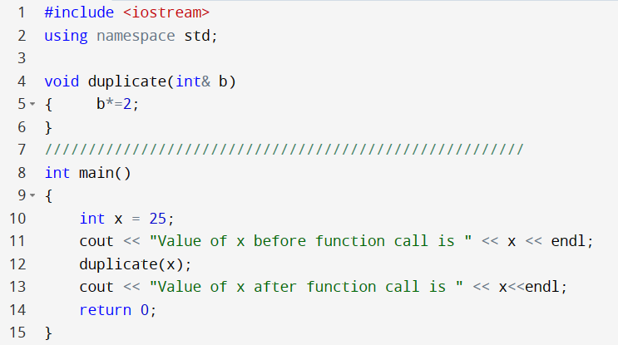
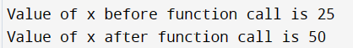

Passing parameters by Reference
Memory
25
x
50
b

Slide 17
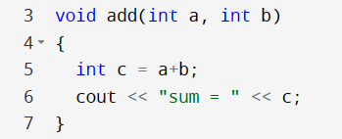
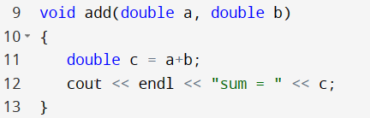
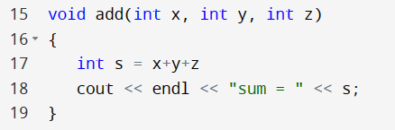
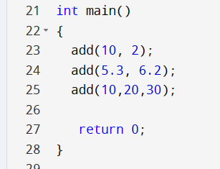



Function Overloading

Slide 18
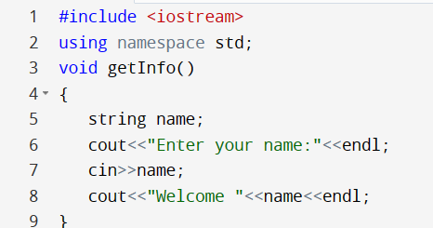
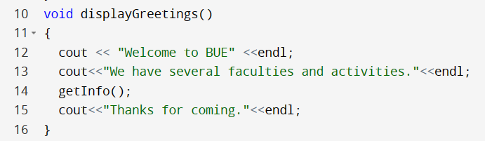
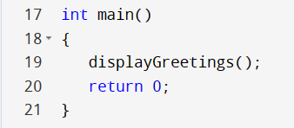
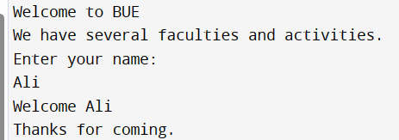
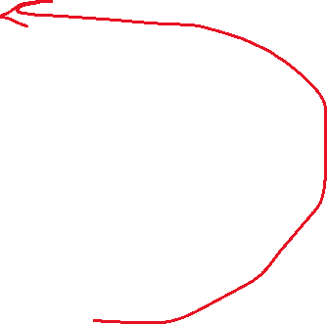



Function calling function
2
3
1
4
getInfo() should be written before displayGreetings()

Slide 19
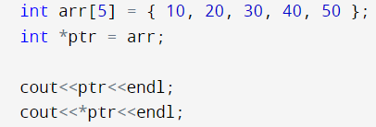
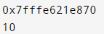
Pointers with arrays
Memory
10
20
30
40
50
arr
ptr

Slide 20
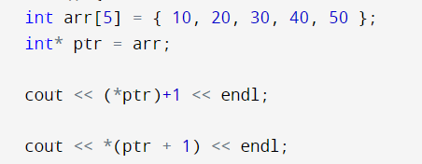

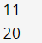
Pointers with arrays
Memory
10
20
30
40
50
arr
ptr
*(ptr + 1) is equivalent to arr[1];
*(ptr + 2) is equivalent to arr[2];
*(ptr + 3) is equivalent to arr[3];
*(ptr + 4) is equivalent to arr[4];

Slide 21
Traversing an array using pointers
int arr[SIZE] = { 20,10,30,40,90,25,50 };
int *ptr = arr;
for (int i = 0; i < SIZE; i++)
{
cout << *ptr << endl;
ptr = ptr + 1;
}

Slide 22
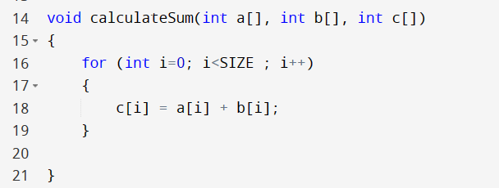
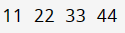
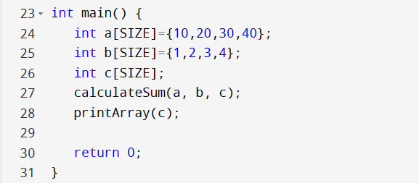
Returning an array in C++
Write a function that sums up the elements of two arrays in a third array.
SIZE is declared as a global variable

Slide 23
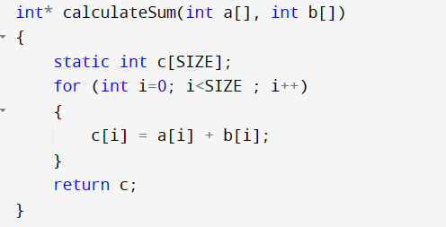
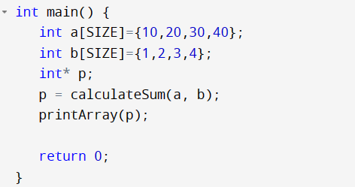



Returning an array in C++
You are returning a pointer to an array which is local to the function. If you declare it as static, it means the lifetime of the array extends until the end of the program.

Slide 24
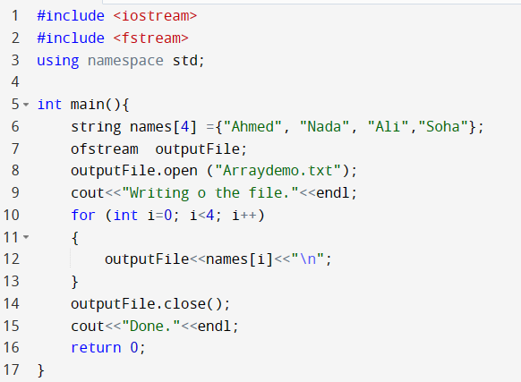
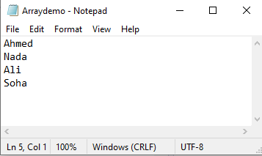
Writing to a file

Slide 25
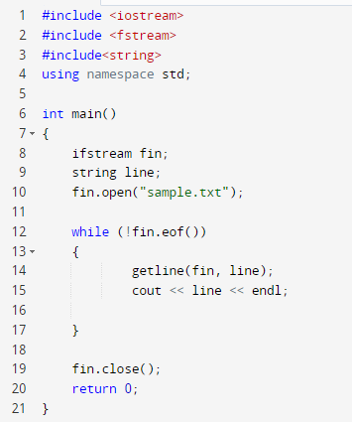
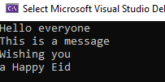
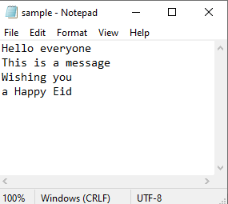

Reading from a file
Write a program that reads the lines written in example 3.
Execute a loop
While not EOF (end of file)

Slide 26
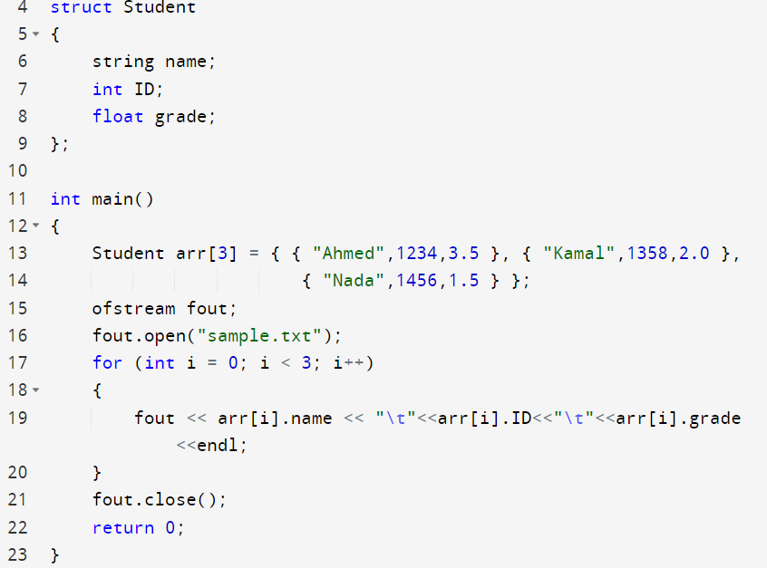
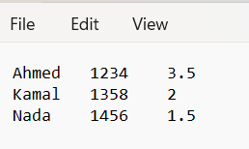
Writing and Reading Array of struct

Slide 27
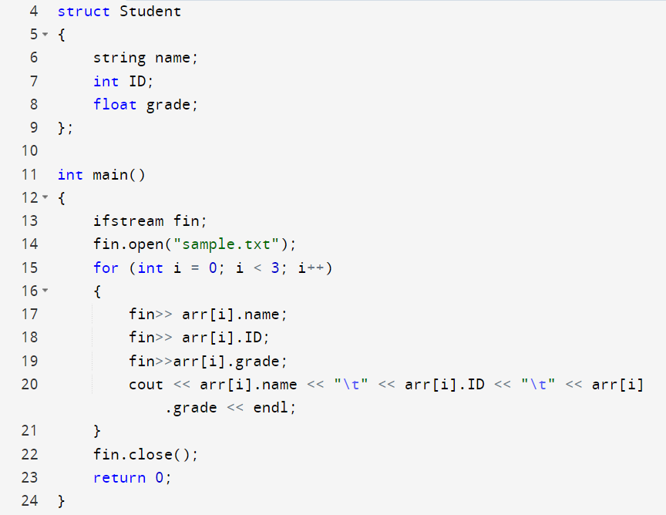
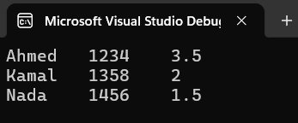
Writing and Reading Array of struct

Slide 28


Passing file stream variable to a function
void writeFile(ofstream& fout, int arr[])
{
fout.open("sample.txt");
for (int i = 0; i < SIZE; i++)
{
fout << arr[i] << endl;
}
fout.close();
}
void readFile(ifstream& fin, int arr[])
{
fin.open("sample.txt");
for (int i = 0; i < SIZE; i++)
{
fin >> arr[i];
cout << arr[i] << endl;
}
fin.close();
}
int main()
{
int arr[SIZE] = { 10,20,30 };
ofstream fout;
ifstream fin;
writeFile(fout, arr);
readFile(fin, arr);
return 0;
}
Passing by reference.
The compiler won’t accept not using &

Slide 29
Exception Handling

Slide 30
Exception Handling
Exception handling in C++ consist of three keywords: try, throw and catch.
The try statement allows you to define a block of code to be tested for errors while it is being executed.
The throw keyword throws an exception when a problem is detected, which lets us create a custom error.
The catch statement allows you to define a block of code to be executed, if an error occurs in the try block.
The try and catch keywords come in pairs

Slide 31
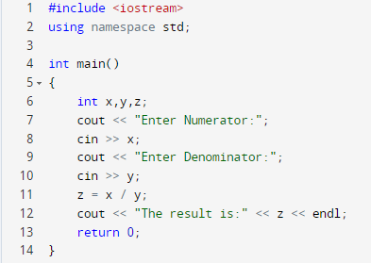
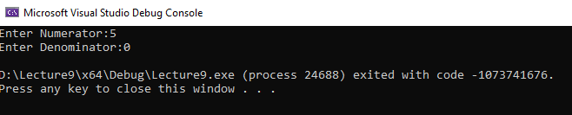
Division by Zero
Program without Exception Handling

Slide 32
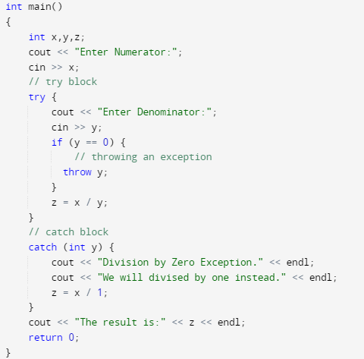
Division by Zero
Program with Exception Handling
Try block
Catch block
The rest of the program

Slide 33
Recursive functions

Slide 34


Example : Factorial using loops
int factorial(int n)
{
int result = 1;
while (n > 0)
{
result = result * n;
n = n - 1;
}
return result;
}
When to stop?
when n=1
This is the base case
What is changing every iteration?
Answer: multiplying with n decremented by 1
i.e: multiply by the factorial of n-1
int main()
{
cout<<factorial(5);
return 0;
}

Slide 35
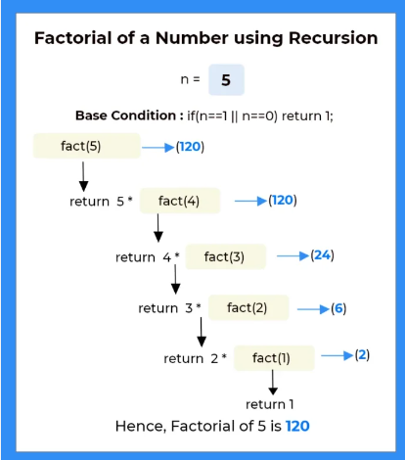
Example : Factorial using recursion
A sketch for tracing the factorial of 5
int factorial(int n)
{
if (n==1)
return 1;
return n * factorial(n - 1);
}
Base case
int main()
{
cout<<factorial(5);
return 0;
}
120

Slide 36
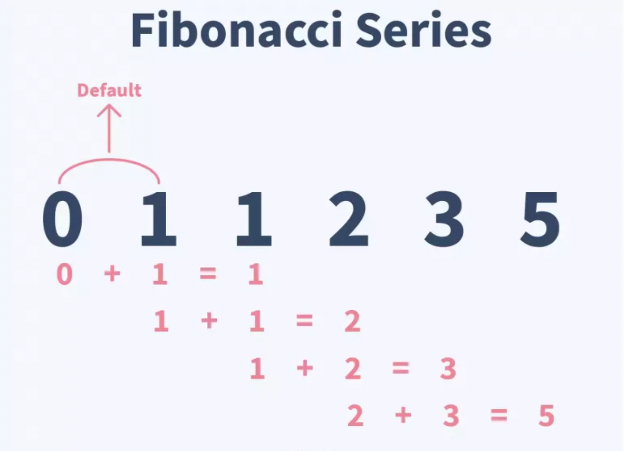
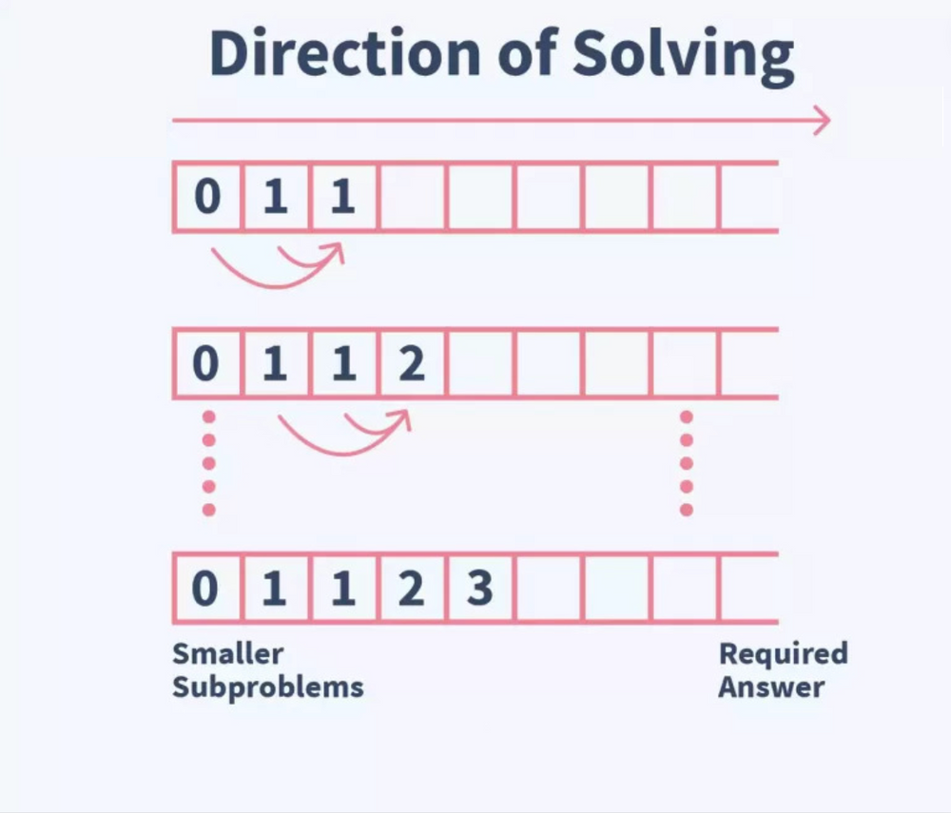
Example : Fibonacci series
Each number is the sum of values at the previous two numbers.
The first two numbers are 0 and 1.
Fibonacci of the 10th term is:
0 1 1 2 3 5 8 13 21 34 55

Slide 37
Example 2 : Fibonacci series
An example to calculate the series till the nth term
int fibonacci(int n)
{
if (n == 0)
return 0;
if (n == 1)
return 1;
return fibonacci(n - 1) + fibonacci(n - 2);
}
2 base cases
int main()
{
cout<< fibonacci(10);
return 0;
}
55

Slide 38
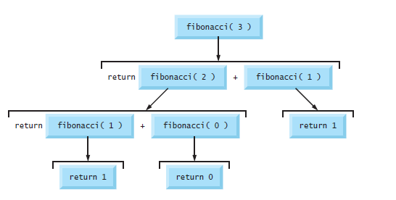







Example : Fibonacci series
An example to calculate the series till the nth term
A sketch for tracing the Fibonacci of 3
int fibonacci(int n)
{
if (n == 0)
return 0;
if (n == 1)
return 1;
return fibonacci(n - 1) +
fibonacci(n - 2);
}
2
2
2 base cases
1
1
1
0
Sketch a tracing tree for Fibonacci of 3, by numbers show the sequence of returning from the callee to the caller function
Notes:
A sketch for tracing the Fibonacci of 3

Slide 39

Thank You & Good Luck

